Slide 1
Bridge Design pattern
The Bridge pattern allows two components, a client and a service, to work together with each component having its own interface.
Bridge is a high-level architectural pattern and its main goal is to write better code through two levels of abstraction. It facilitates very loose coupling of objects.
It is sometimes referred to as a double Adapter pattern.
@ShankaragoudaG

Slide 2
Bridge Design pattern
Bridge pattern is an application (the client) and a database driver (the service).
The application writes to a well-defined database API, for example ODBC, but behind this API you will find that each driver's implementation is totally different for each database vendor (SQL Server, MySQL, Oracle, etc.).
The Bridge pattern is a great pattern for driver development but it is rarely seen in JavaScript.

Slide 3
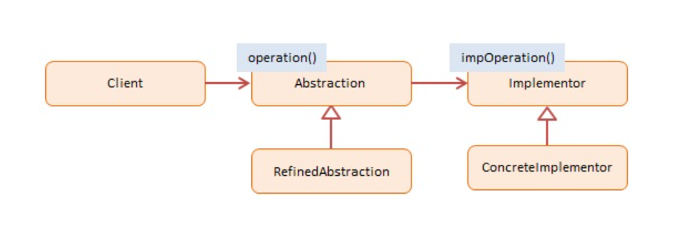
Diagram
Client --
calls into Abstraction to request an operation
Abstraction -- not used in JavaScript
declares an interface for first level abstraction
maintains a reference to the Implementor
RefinedAbstraction -- In example: Gestures, Mouse
implements and extends the interface defined by Abstraction
Implementor -- not used in JavaScript
declares an interface for second level or implementor abstraction
ConcreteImplementor -- In example code: Screen, Audio
implements the Implementor interface and defines its effects

Slide 4
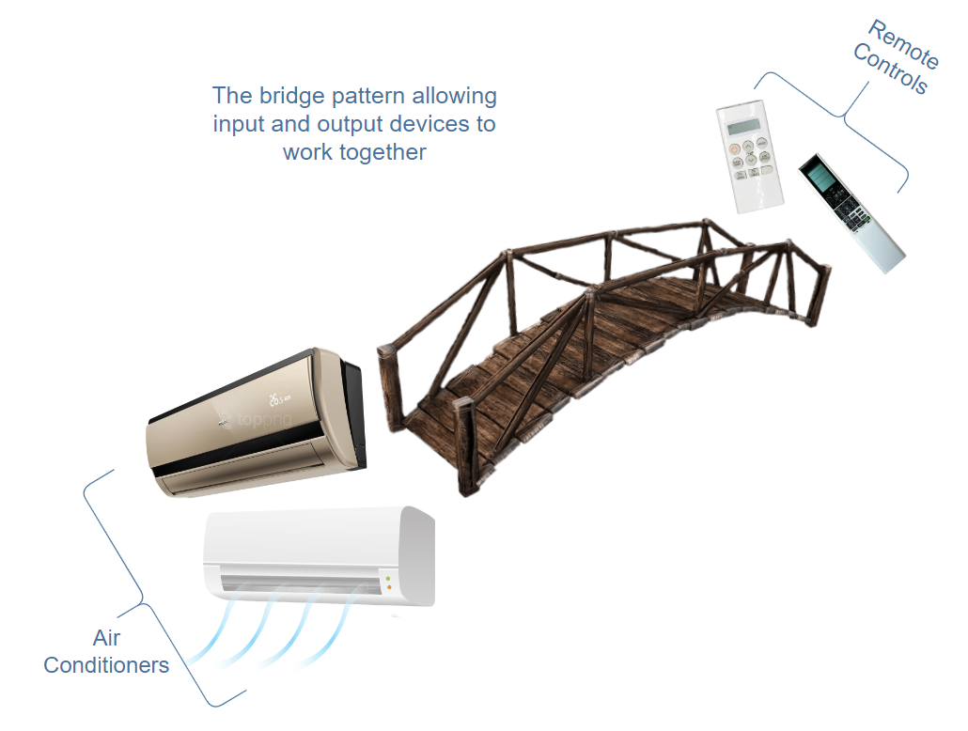
Bridge Design pattern

Slide 5
Continued...
An example is of controlling an air conditioner with a remote. The air conditioners can be of different types, similarly, each of them is controlled by a different remote.
The remotes can vary, that is, a new one with better features can be introduced but that won’t make any changes to the air conditioner classes.
The same goes the other way around. Hence, the bridge pattern allows input and output devices to work together but vary independently.

Slide 6
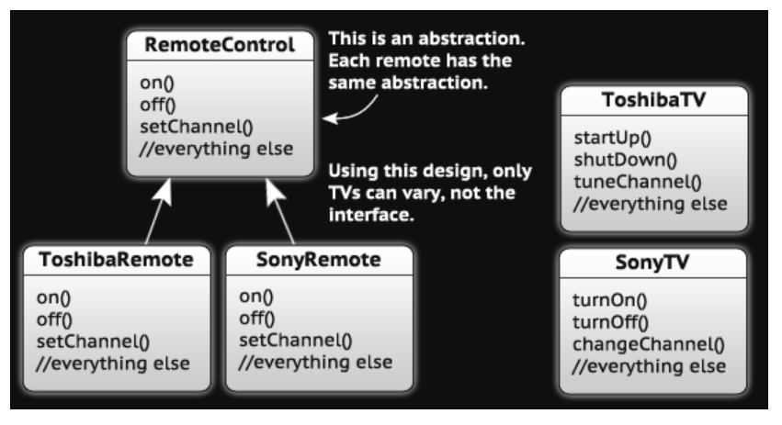
Example
The RemoteControl Interface. ToshibaRemote and SonyRemote both implement that interface to work with their respective televisions. With this code, you can call on(), off(), or setChannel() on any remote and even though all the TVs are different, it’ll work.

Slide 7
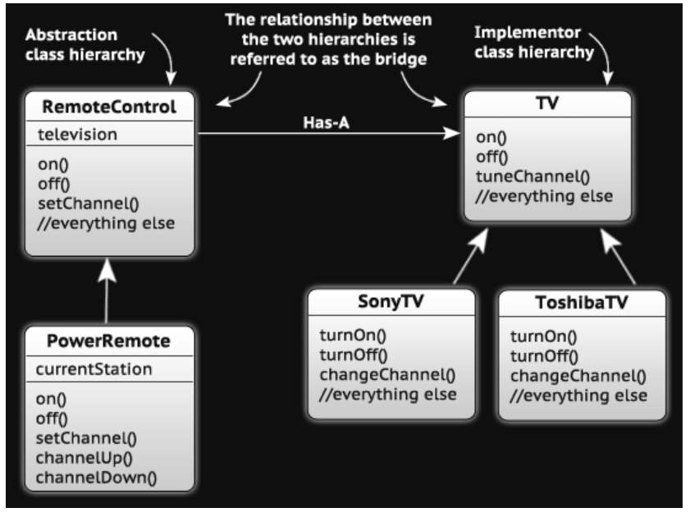
Continued...

Slide 8
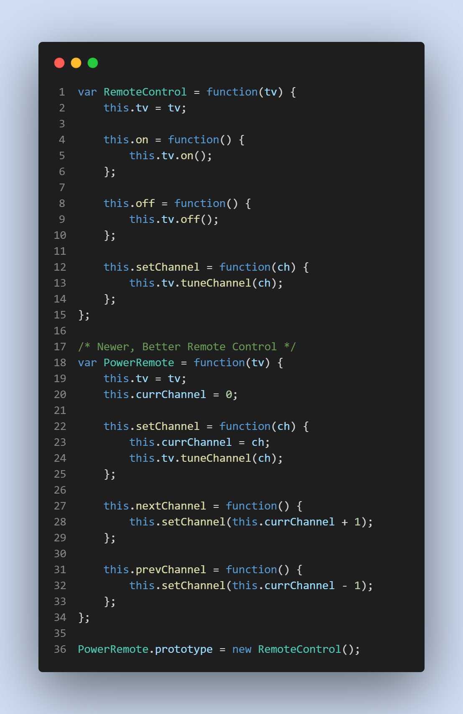
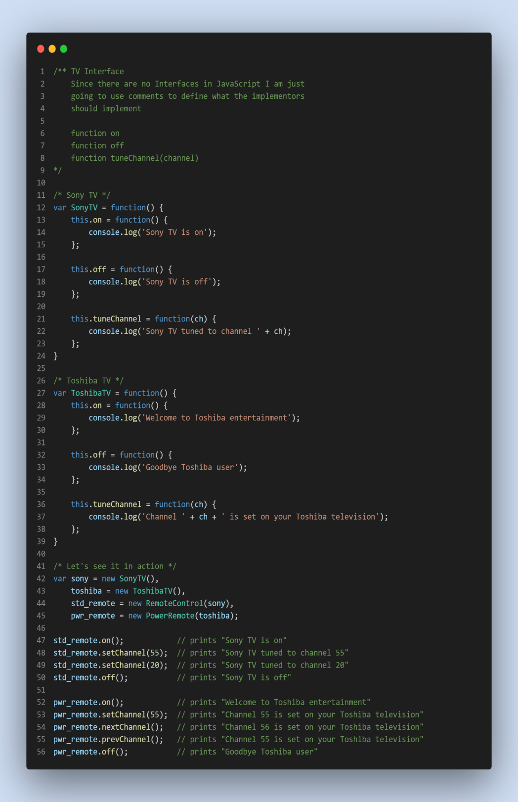

Slide 9
Useful resources
https://www.educative.io/collection/page/5429798910296064/5725579815944192/4525900851838976
https://www.joezimjs.com/javascript/javascript-design-patterns-bridge/
https://www.dofactory.com/javascript/design-patterns/bridge

